Slide 1
Causes of the Civil War
Supplementary Notes for Foldable

Slide 2
Bellwork-- Thursday 3/31
Fill out HW/CW
Get out composition book
What is a civil war? How is that different from other wars? Have there been other civil wars?

Slide 3
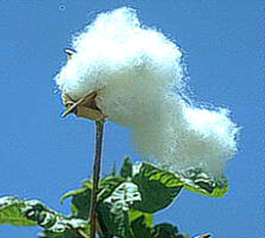
Economic Differences
Northern Economy focused on Industry and Manufacturing
Factories provided work/wages
Women, children, Immigrants
Southern Economy focused on agriculture and cash crops
“King” cotton
Dependant on slave labor

Slide 4
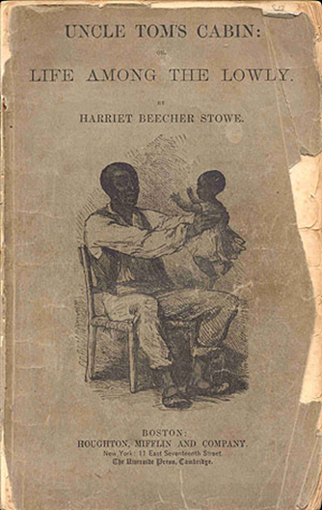
Abolitionist Movement
Many people worked tirelessly to end slavery and make it illegal
Underground Railroad
Secret escape route from slavery to freedom
Allowed Northerners to be exposed to former slaves- hear their stories and experiences
INCREASED Anti-slavery sentiment
Uncle Tom’s Cabin
Novel written by novelist Harriet Beecher Stowe
Depicts the HORRORS of life as a slave.
Led many people to join abolitionist cause
First glimpse at mistreatment, violence, and inhumanity
experienced by slaves.

Slide 5
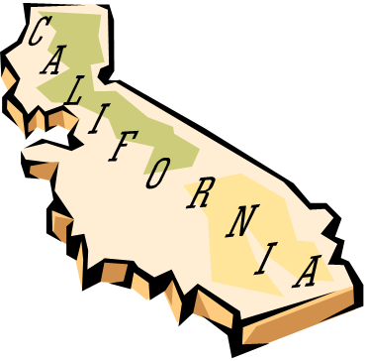
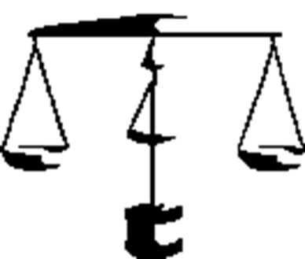
Compromise of 1850
Replaces Missouri Compromise
Brought up to ease tensions over amount of slave/ free states as California was admitted to the USA:
CA was to be a FREE State (free now outnumber slave)
Banned slave trade in Washington DC
Admittance of NEW territory would be based on popular sovereignty (No longer geographic coordinates)
Harsher fugitive slave laws

Slide 6
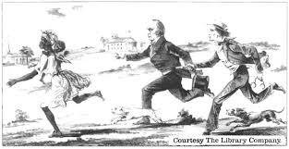
Fugitive Slave Act (Part of Compromise of 1850)
Slave catchers were allowed to recapture (without a warrant) runaway slaves and sell them back to the South
“Bloodhound law”
“Escaped slaves” had no rights
Much corruption with this law. Many abolitionists defied this law.

Slide 7
KS/ NE Act (Bleeding Kansas)
People of KS Territory and NE Territory will decide slave state or free state
(According to MO Comp. they would have been free states)
Many abolitionists move here to prevent slavery
Proslavery supporters move here to ensure they enter as slave states
DISAGREEMENTS turn VIOLENT

Slide 8
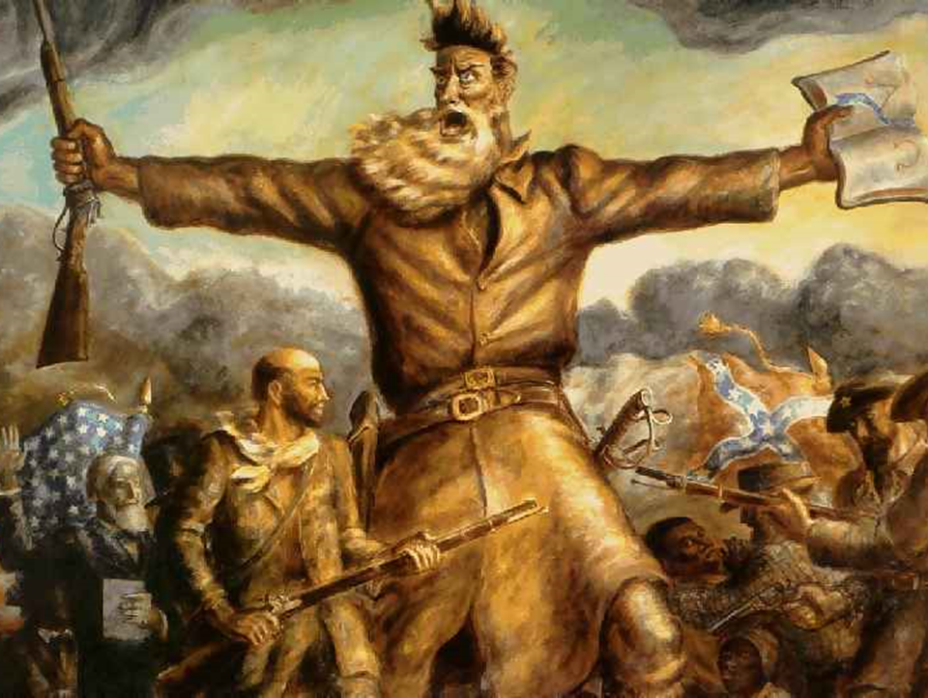

Slide 9
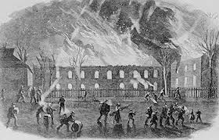
Harper’s Ferry/ John Brown’s Raid
John Brown (abolitionist) plotted to steal guns from federal arsenal to arm slaves and fight for freedom.
Unsuccessful- Brown was captured and hung
Left Southerners in fear of slaves and fueled PROSLAVERY movement

Slide 10
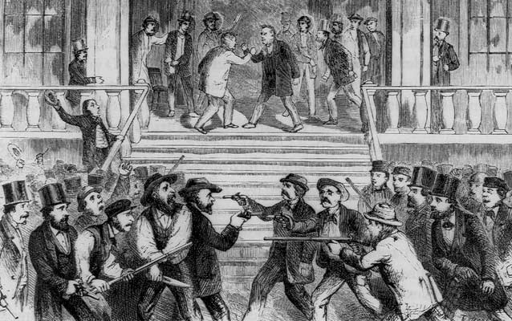

Slide 11
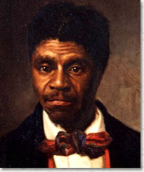
Dred Scott Case
Slave from Missouri, moved to IL temporarily with owner, after owner’s death he sued for freedom based on fact he had lived in free state.
Supreme Court denies his claim- slaves were not citizens they did not have the right to sue.
Court viewed slaves as property, not people

Slide 12
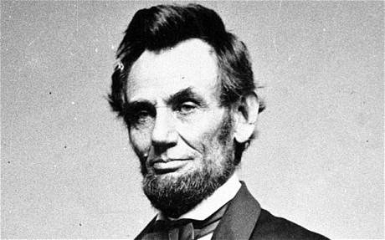
Election of 1860
Republican Candidate: Abraham Lincoln
Southern Democrat: John Breckinridge
Northern Democrat: Stephen Douglas

Slide 13
Lincoln Douglas Debates: Slavery was Main Issue
Lincoln and Douglas held formal debates throughout Illinois and set the standard for modern day political debates

Slide 14
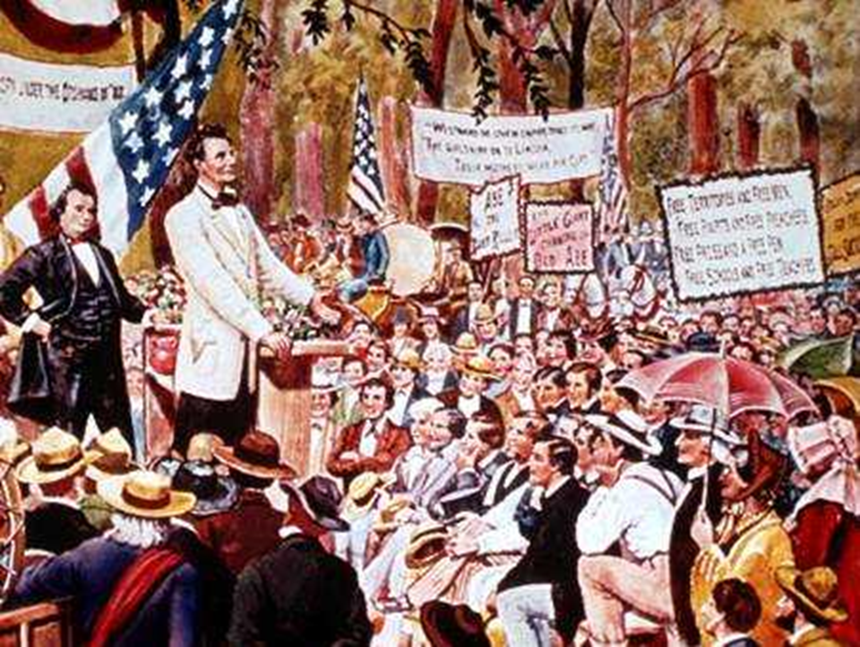

Slide 15
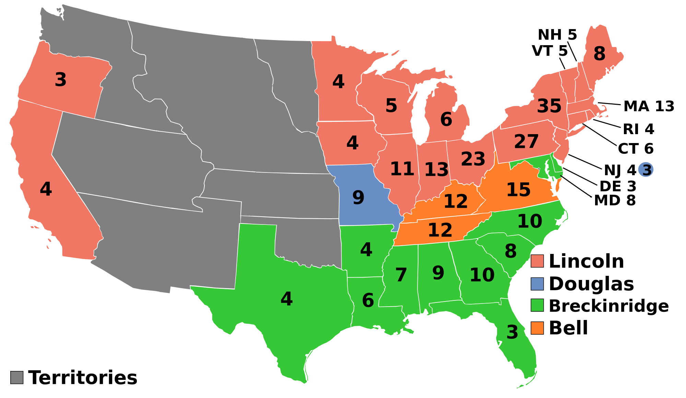
Lincoln WINS!!
North has HIGH population, vote for Lincoln
Southern votes split between two candidates
LINCOLN WINS!!!

Slide 16
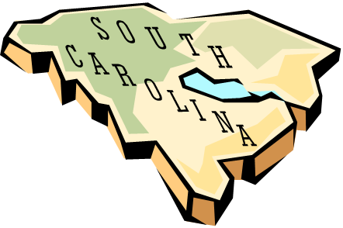
SECESSION
South is now worried that Lincoln will try to abolish slavery in the USA.
South Carolina becomes first state to secede from Union on
Dec. 20, 1860.

Slide 17
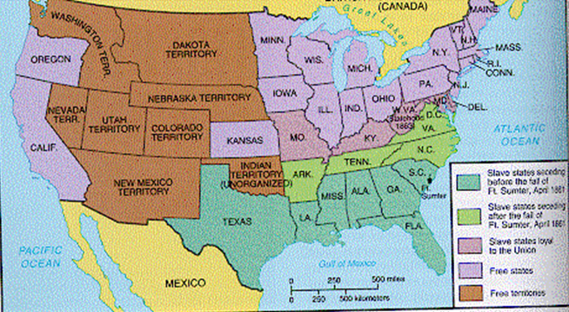
In the next 6 weeks, more states secede:
Mississippi, Alabama, Florida, Georgia, Louisiana, Texas

Slide 18
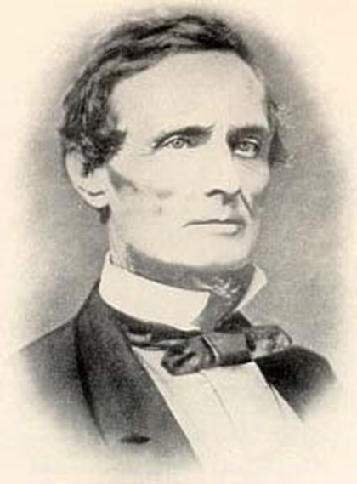
These states form THE CONFEDERATE STATES OF AMERICA (CSA)
They elect Jefferson Davis as President of the CSA

