Slide 1
Bellwork-- Monday 5/8
Fill out CW/HW
Turn in Mindmap if missing
Grab Clara Barton article from front desk
Read and answer questions in composition book (class copy)

Slide 2
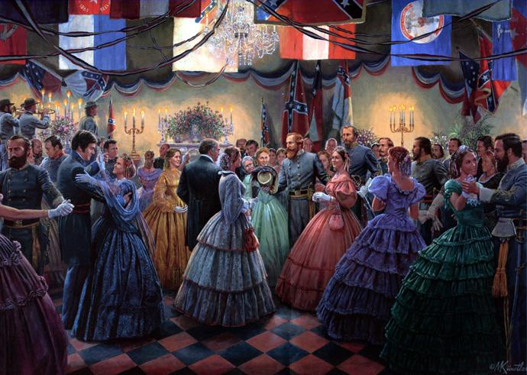
WAR AND SOCIETY

Slide 3
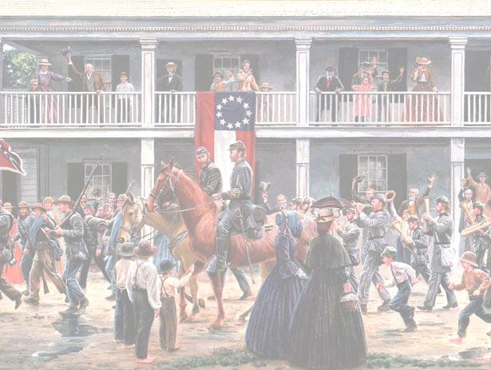
EMANCIPATION PROCLAMATION – an executive order given by President Lincoln
ORDERING the freeing all slaves in the Confederate states
Did not free any slaves but helped war effort

Slide 4
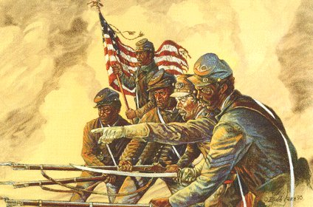
By the end of the war 180,000 African American soldiers had served in the Union army

Slide 5
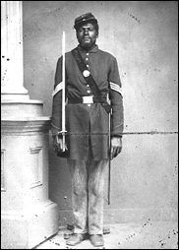
54th MASSACHUSETTS REGIMENT – one of the first all black Union regiments
Famous for attack on Fort Wagner in South Carolina

Slide 6
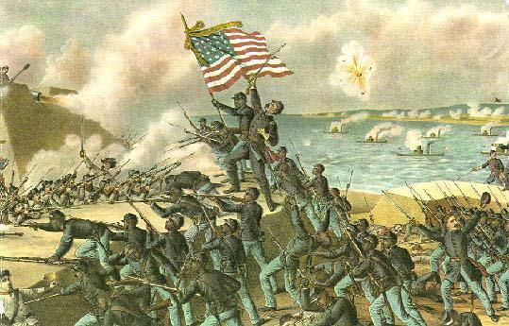

Slide 7
By the end of 1863 the confederate army had lost 40% of its men
People in both the North and South were questioning why the war was being fought

Slide 8
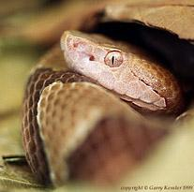
COPPERHEADS – Democrats in the North who want to end the war and make peace with the South
a Copperhead is a type of snake

Slide 9
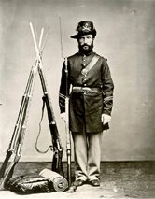
CONSCRIPTION – a draft, requiring people to serve in the military
Both the Union and Confederacy have a draft- it incited riots in the South

Slide 10
Supply and food shortages occur in both the North and South
Inflation hits the South – during the war prices go up 9000%
X

Slide 11
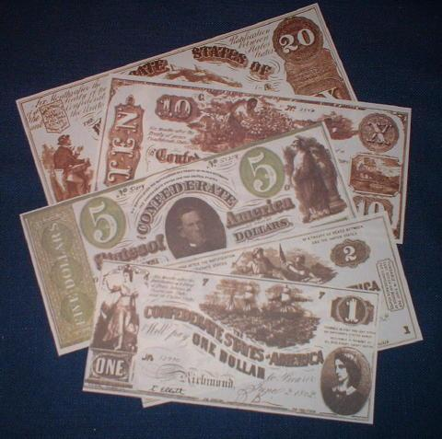

Slide 12
In 1861 the national government establishes an INCOME TAX to pay for the war

Slide 13
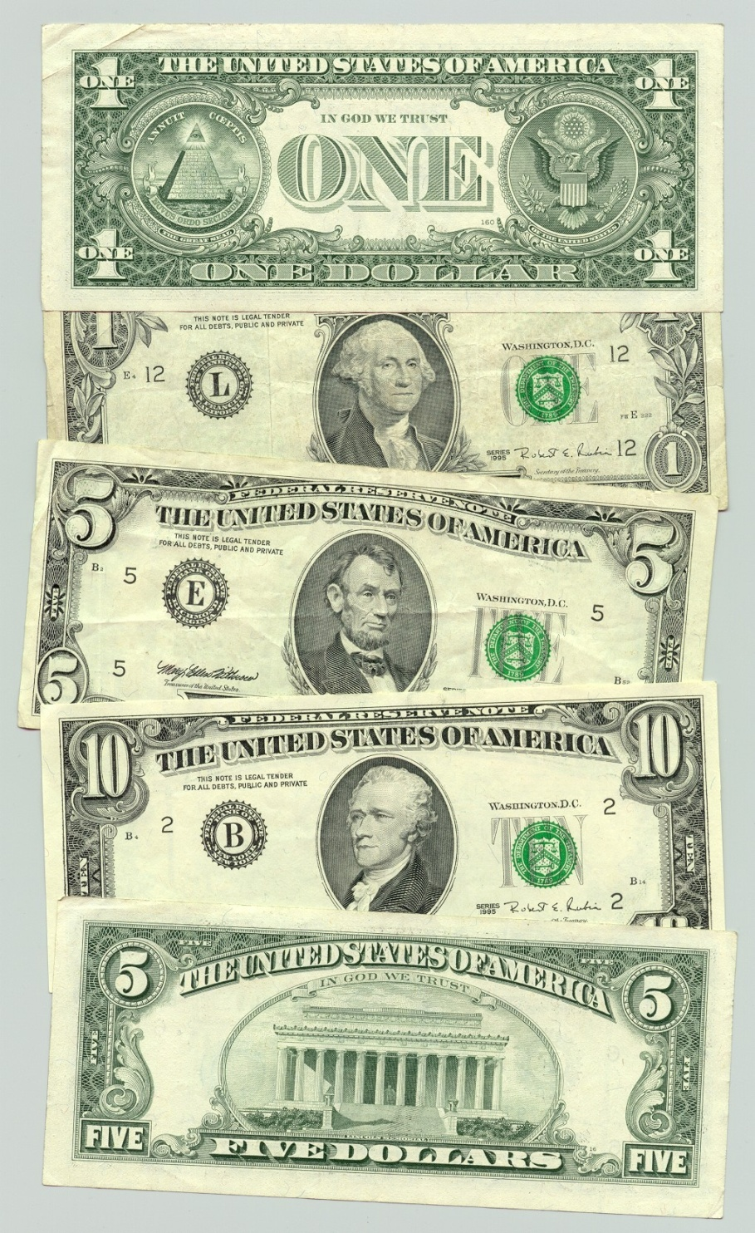
In 1862 the government issues a new type of money – called GREENBACKS because of its color

Slide 14
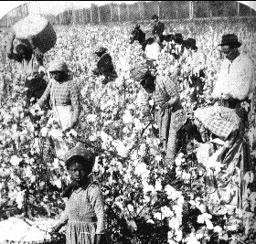
Slaves begin to resist more in the South – refuse to work, break things on purpose
Advancing Union troops free slaves

Slide 15
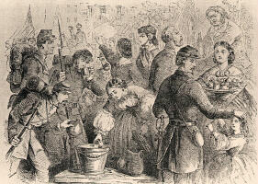
Women also help the war effort in many ways – relief agencies, nurses, spies, factory workers

Slide 16
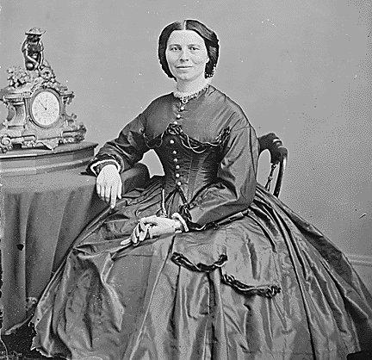
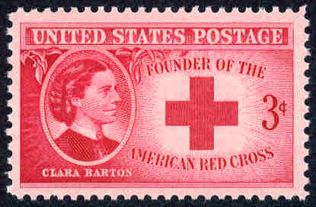
CLARA BARTON – nurse during the Civil War, helped with supplies, later started American Red Cross

Slide 17
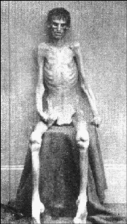
Each side took prisoners of war
Many POW’s died in camps because of no food, poor shelter, disease, overcrowding

Slide 18
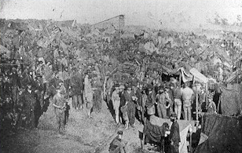
ANDERSONVILLE – Confederate POW camp in Georgia, built to house 10,000 but at one point had 33,000

Slide 19
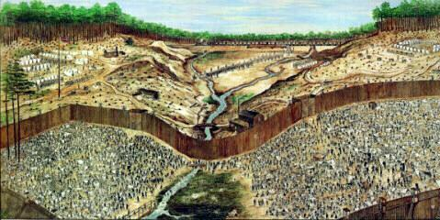
Around 50,000 soldiers died in POW camps

Slide 20
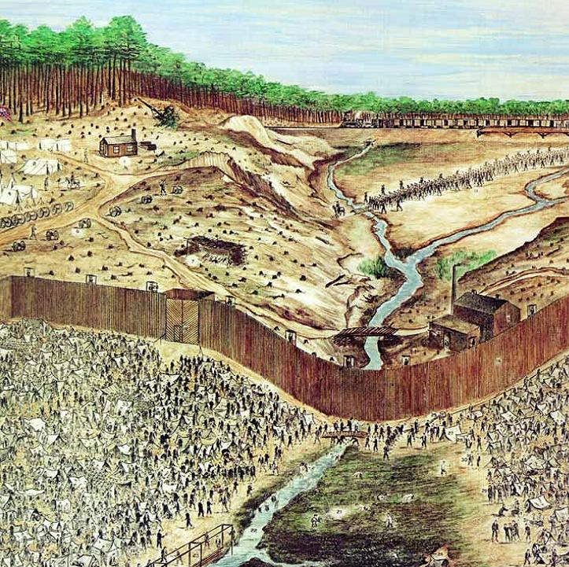
ANDERSONVILLE
http://www.cr.nps.gov/nr/twhp/wwwlps/lessons/11andersonville/11getting.htm
This painting was done by an prisoner from memory that was at Andersonville

Slide 21
Emancipation Proclamation

Slide 22
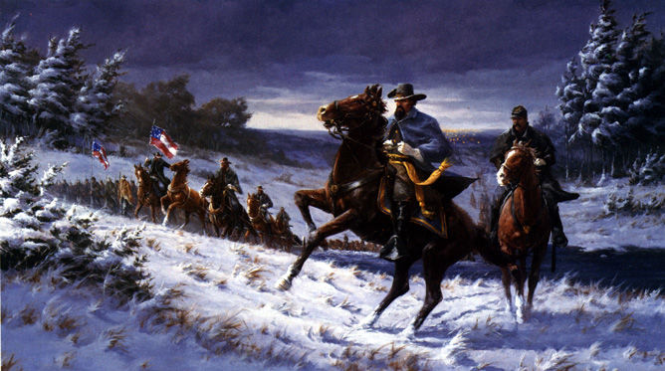
THE
END

