Slide 1
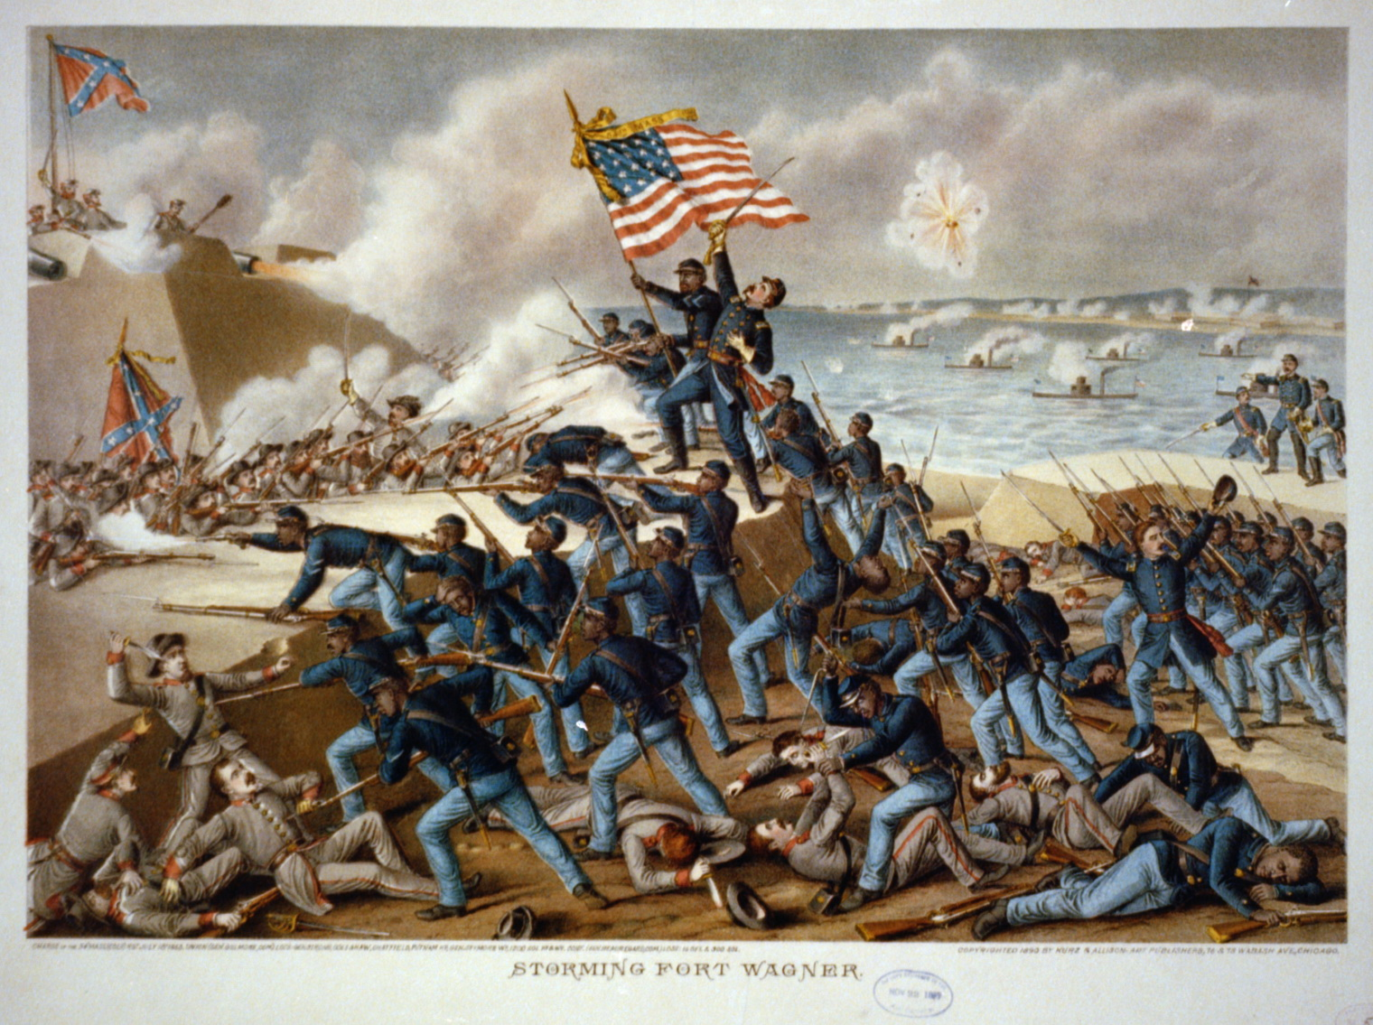
Bellwork-- Tuesday 5/9
Fill out CW/HW
Grab 54th Massachusetts w/s off front desk. Read and answer the questions

Slide 2
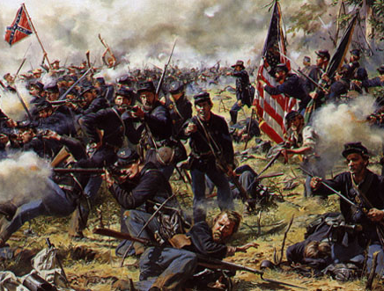
NORTH WINS

Slide 3
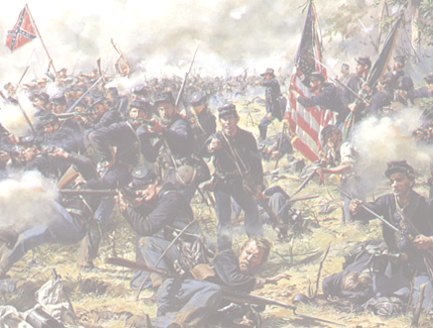
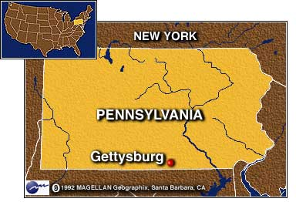
Lee’s Southern troops met the Union at GETTYSBURG in Pennsylvania – July 1863
90,000 Union troops against 75,000 confederate troops

Slide 4
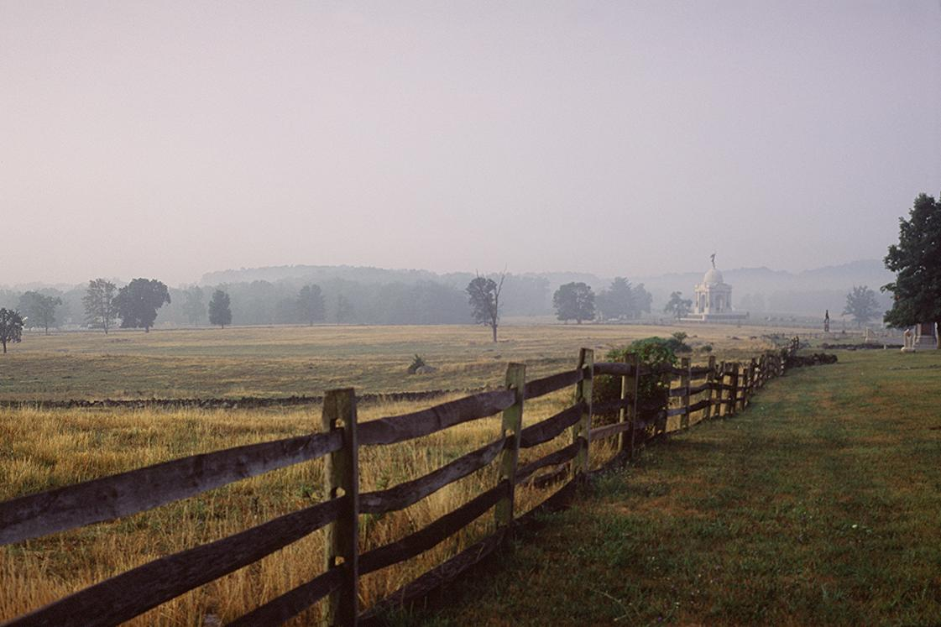
GETTYSBURG BATTLEFIELD

Slide 5
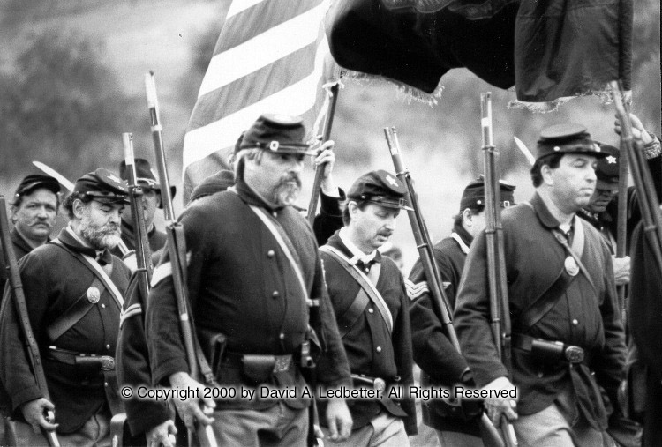
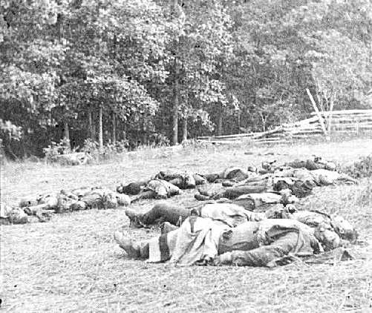
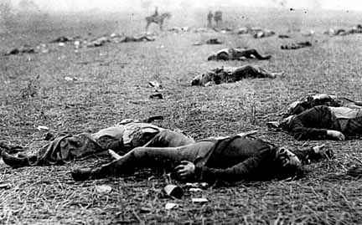
GETTYSBURG BATTLEFIELD

Slide 6
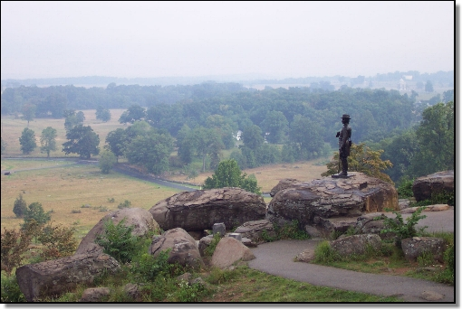
GETTYSBURG BATTLEFIELD

Slide 7
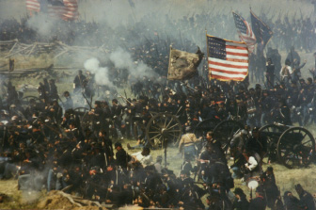
PICKETT’S CHARGE:
Southern General George Pickett tried to march his men across a wheat field and are mowed down by Union soldiers

Slide 8
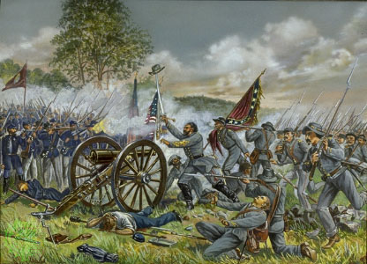
PICKETT’S CHARGE - GETTYSBURG

Slide 9
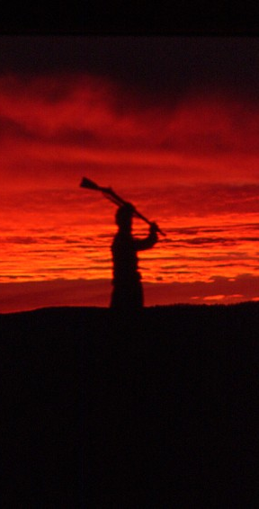
North wins the Battle of Gettysburg
Union has 23,000 soldiers dead and wounded and Confederacy has 28,000
Video

Slide 10
The day after Gettysburg, General Grant led the Union to a victory at VICKSBURG along the Mississippi
Union surrounds the city and starves out the people until they are forced to give up

Slide 11
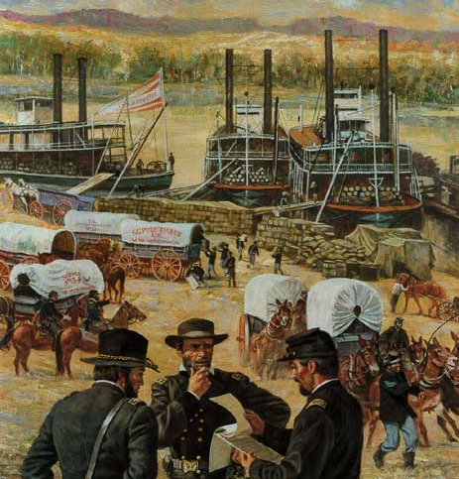
The victory at Vicksburg gives the Union total control over the Mississippi River
Union now has the momentum

Slide 12
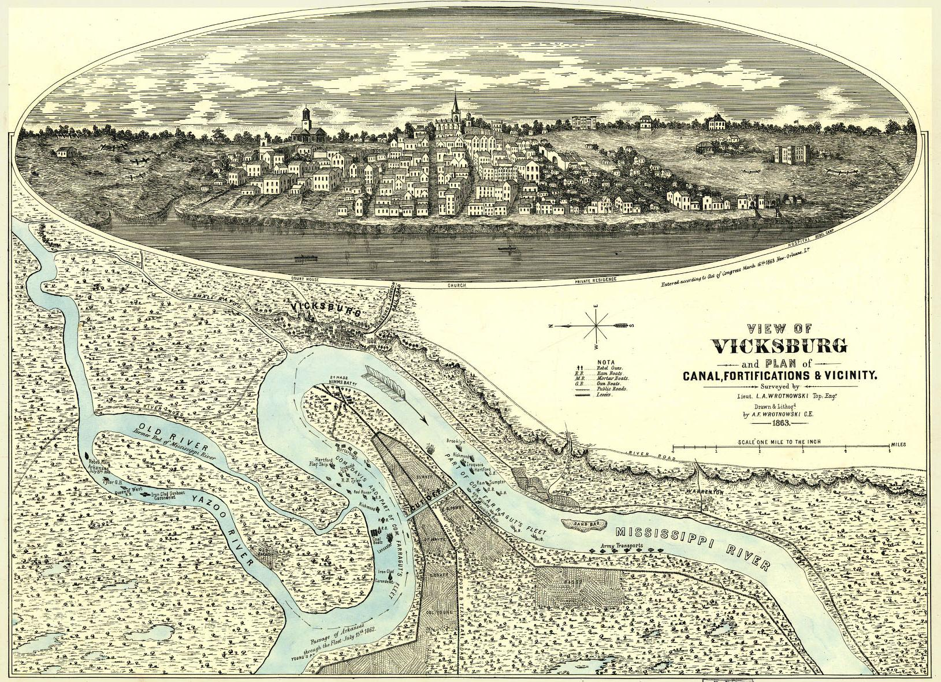
BATTLE OF VICKSBURG

Slide 13
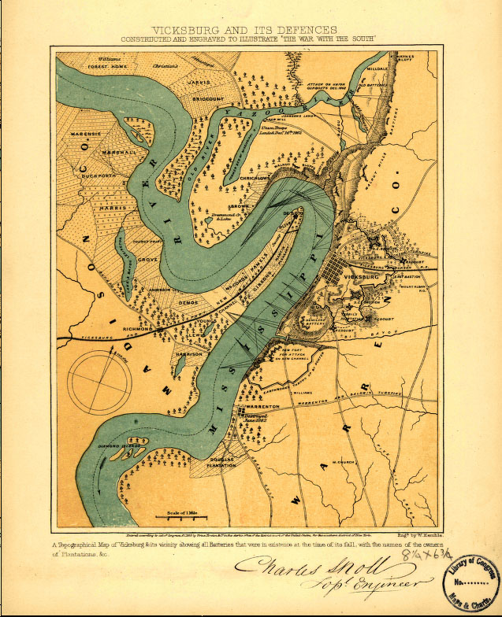
VICKSBURG, MISSISSIPPI

Slide 14
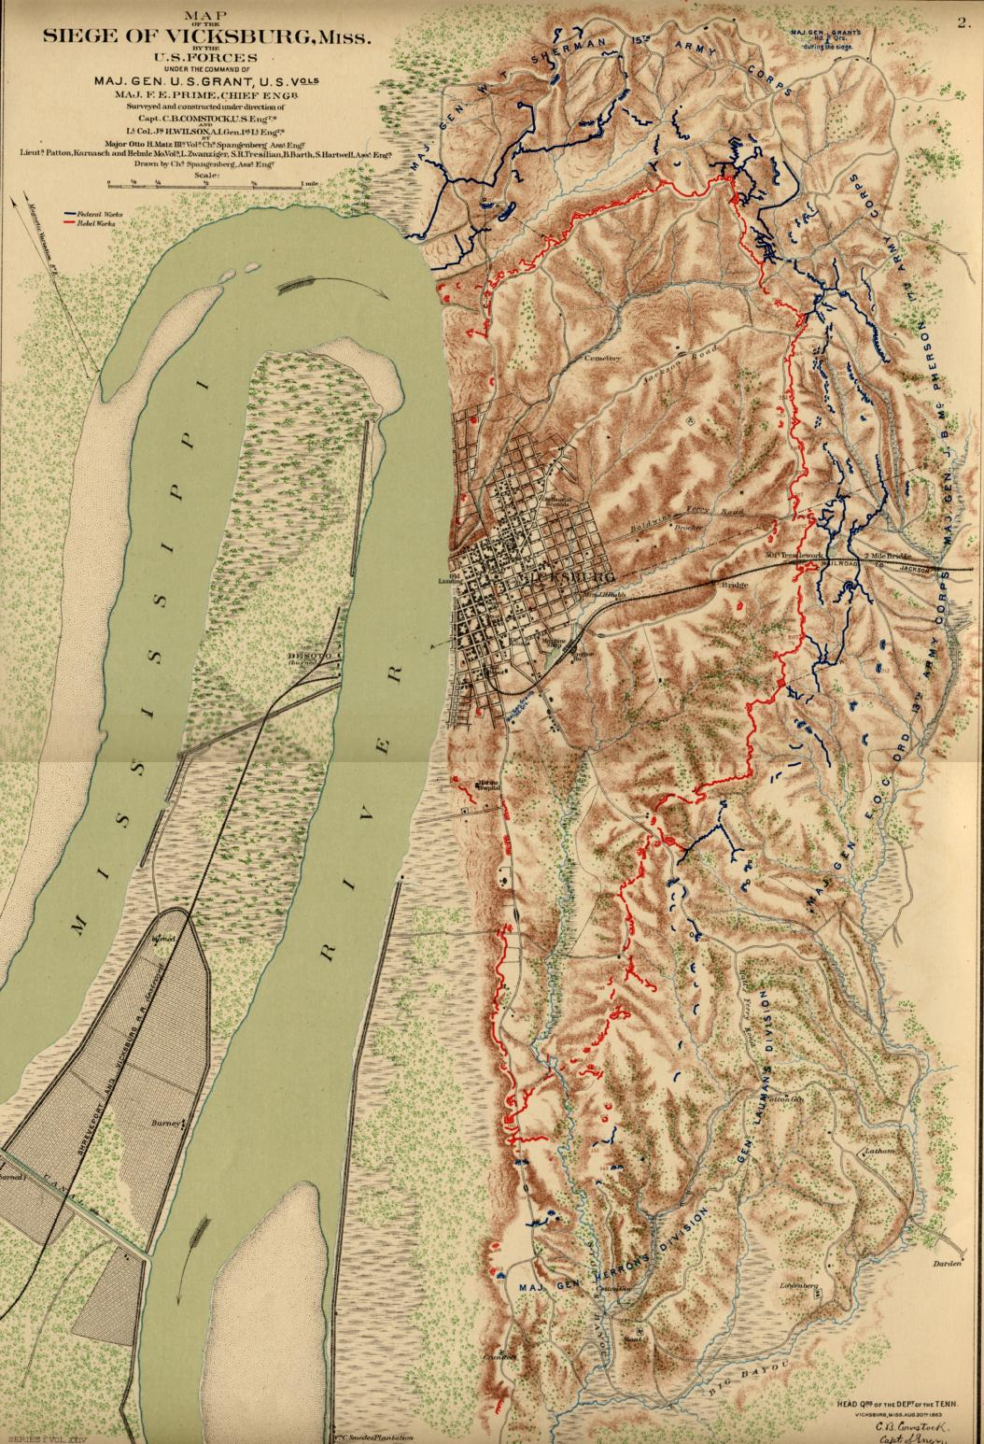
SEIGE OF VICKSBURG
BLUE = UNION
RED = CONFEDERATES

Slide 15
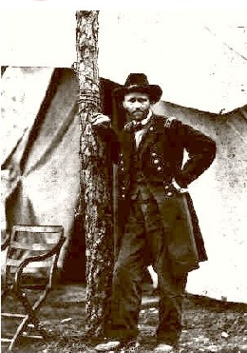
Lincoln fires McClellan and places Ulysses S. Grant in charge of the entire Union army

Slide 16
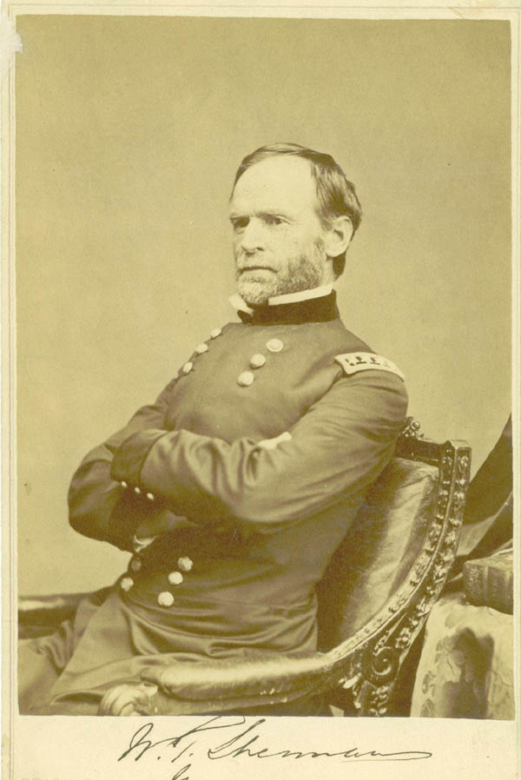
Union General WILLIAM SHERMAN drives an army through the South to further divide the Confederacy

Slide 17
Union wants to break the South’s will to fight with TOTAL WAR
Union army marches to the Sea destroying everything for a 300 mile long stretch (60 miles wide) throughout Georgia

Slide 18
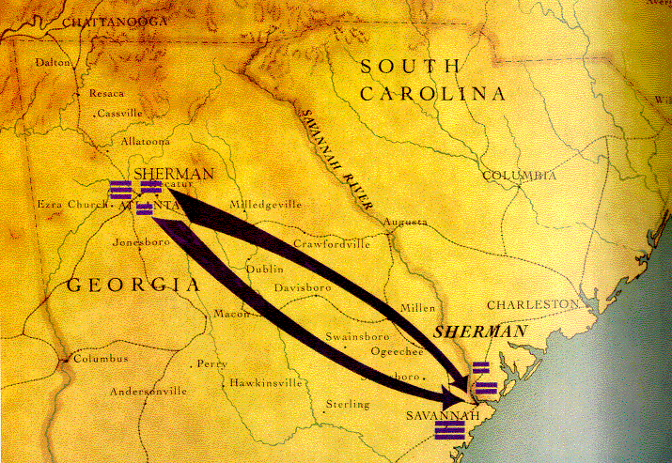
THE UNION’S “MARCH TO THE SEA”

Slide 19
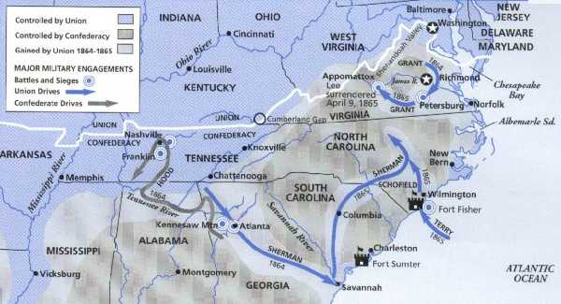
THE UNION’S “MARCH TO THE SEA”

Slide 20
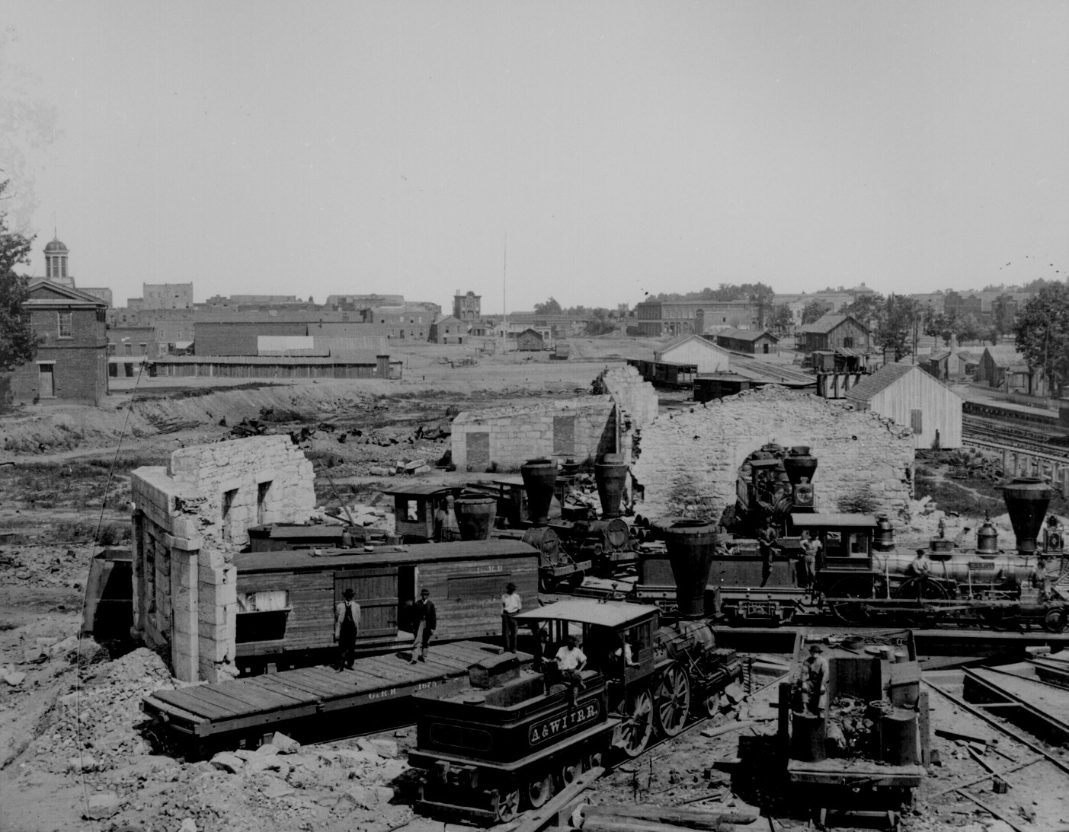
THE UNION’S “MARCH TO THE SEA”

Slide 21
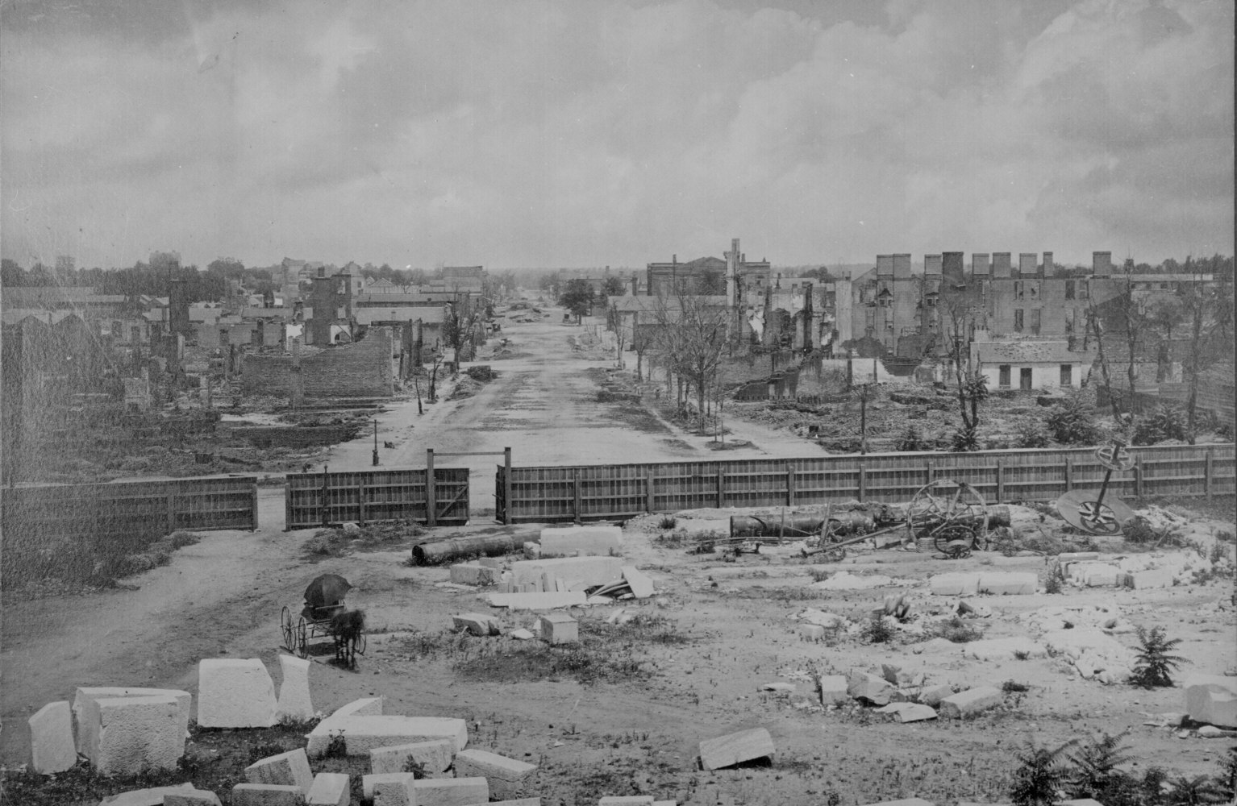
THE UNION’S “MARCH TO THE SEA”

Slide 22
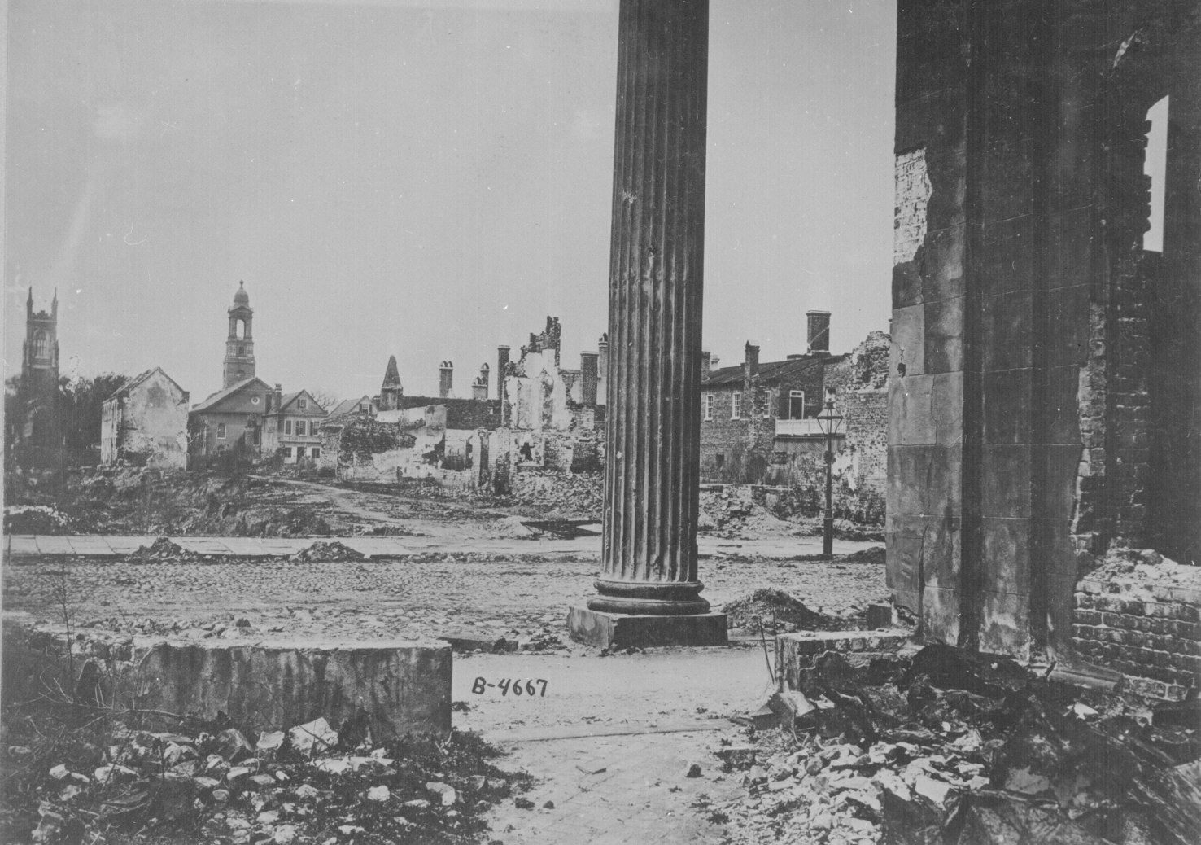
THE UNION’S “MARCH TO THE SEA”

Slide 23
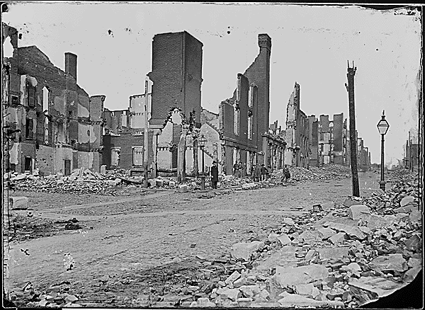
THE UNION’S “MARCH TO THE SEA”

Slide 24
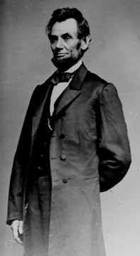
Lincoln is re-elected President in 1864 for his second term

Slide 25
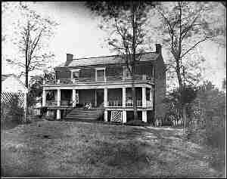
Grant meets Lee in Virginia and defeats the South
Lee surrenders at APPOMATTOX COURT HOUSE, VIRGINIA on April 9, 1865
Video

Slide 26
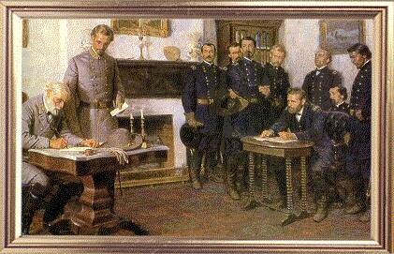
SIGNING THE SURRENDER PAPERS

Slide 27
The Union soldiers were gracious in victory
Confederate soldiers were given food and allowed to go home
The war that had lasted four long years was finally over

Slide 28
THE
END

