Slide 1
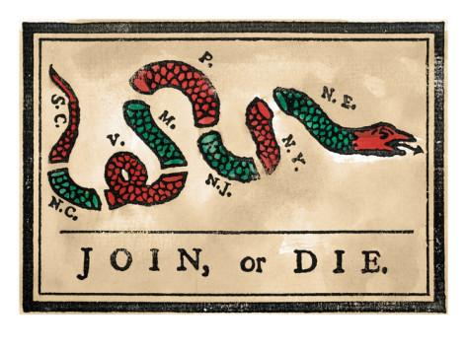
Bellwork-- Tuesday 11/1
Fill out CW/HW
Using the picture below and the chart on page 147, answer the following:
What do you notice about the snake cartoon?
What does the snake represent?
Which factor on pg. 147 do you think was most important in creating an American identity?

Slide 2
Chapter 6
Section 1: Tighter British Control

Slide 3
Growing Apart
Colonists had helped the British defeat the French in the war – but relationship has soured
By 1760’s, parliament’s laws and restrictions threatened the colonists’ freedom

Slide 4
Proclamation of 1763
Issued by King George III
Forbade the colonists from settling beyond the Appalachian Mountains.
Designed to maintain peace w/ Natives – angered colonists who wanted to speculate land

Slide 5
Quartering Act
Troops were placed in colonies to enforce laws but this was expensive
The Quartering Act was passed to require colonists to house all British soldiers

Slide 6
Sugar Act
Britain had a lot of debt after the French and Indian War
Passed Sugar Act to make $$
Tax on sugar, molasses, and other products shipped to the colonies

Slide 7
Stamp Act
Law that required all legal and commercial documents to carry an official stamp showing that a tax had been paid.
All newspapers and diplomas had to carry a stamp as well

Slide 8
Colonists Defy Parliament
Colonists felt that Parliament had no right to tax the colonies and that no tax should be created without their consent
Patrick Henry and others began to cry “No taxation without representation”
Colonists form the Stamp Act Congress to petition the King to repeal the act
Secret societies formed and they boycotted British goods.

Slide 9
Greeting Card
Directions: Make a greeting card from King George to the Colonists. Your card will focus on a new tax that is being implemented. You may choose from the Quartering Act, Sugar Act, Stamp Act(p.158), Townshend Acts (p.162), or the Tea Act (p.164). You must include the name of the act and what is being taxed and the reason for the tax. Include details of how the colonists will be impacted.

