Slide 1
Bellwork-- Tuesday 11/15
Fill out CW/HW
Missing work = Catch-up club Friday
The Declaration of Independence has been called the “birth certificate of the United States.” What do you think this statement means?

Slide 2
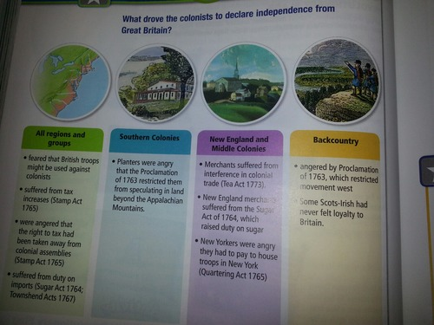
Bellwork-- Monday 11/14
Which one of these do you think is the most important? (pg. 182)

Slide 3
Chapter 6
Section 4: Declaring Independence

Slide 4
Provisions of the Intolerable Acts
Boston Harbor closed until colonists pay for destroyed tea
British officials accused of crimes in the colonies would stand trial in Britain
Committees of Correspondence were banned
British troops would be allowed to be housed wherever necessary
Parliament appointed General Thomas Gage, governor of Massachusetts

Slide 5
The Siege of Boston
After Lexington and Concord, the British troops retreated to Boston
Militia men took Boston under siege
Colonists attack Fort Ticonderoga
At the same time, Second Continental Congress began meeting in Philadelphia
They agreed to create a Continental Army – to be led by George Washington

Slide 6
Battle of Bunker hill
Militiamen were positioned on Breeds Hill and Bunker Hill
British were alarmed and decided to attack
Bostonians watched in horror as Charleston was set on fire
Prescott tells troops “Don’t fire until you see the whites of their eyes!”
Redcoats won the Battle but at a tremendous cost.
https://youtu.be/yHkQCfu2cwc

Slide 7
Conflict Spreads
Most colonists hoped for peace
Olive Branch Petition is sent to London
King rejects petition and begins to punish colonists with blockades and hired soldiers
Washington devises a plan and begins to train the army
Tried to attack through Quebec but failed

Slide 8
Siege in Boston continues
British soldiers were forced to retreat by ship and they would never return to Boston

Slide 9
Rebellion becomes Revolution
Americans began to debate the crisis – should they break with Britain or work it out?
The publication of a pamphlet by Thomas Paine, Common Sense, helped convince many to fight for independence
Continental Congress remained undecided
In May of 1776 Congress adopted a resolution to establish its own government

Slide 10
A draft of the Declaration of Independence was commissioned
The group told Thomas Jefferson to compose the Declaration – he was a good writer and they needed VA support
On July 4, 1776 Congress adopted the document that proclaimed independence
https://www.youtube.com/watch?v=Eytc9ZaNWyc&index=1&list=PLZW3KrFF-F2fKvO6mMGq2SI7VsdZ1F4D3

