Slide 1
CIVIL WAR

Slide 2
Bellwork-- Friday 4/22
Fill out CW/HW
What is an ironclad? Why did this have such a big impact on warfare?
What other weapon advancements did we have during this time period?

Slide 3
Bellwork-- Monday 4/11
Fill out HW/CW
Make sure your atlas assignment is complete and turn it into the black tray.
What two groups fought in the Civil War?

Slide 4
Bellwork-- Tuesday 4/12
Fill out HW/CW
Using the book and the map on page 478 - 479, answer the following questions:
How did climate and geography help create the nation’s sectional division?
Where was cotton grown?
What was the difference in climate between the North and South?
What impact do you think that will have on the armies?
What part do you think the major waterways will play in the Civil War?

Slide 5
Grab a handout from the stool
Read and answer critical thinking question
In the first two years of the war, which side seemed closer to achieving its strategic goals?
Write at least a paragraph

Slide 6
Bellwork-- Wednesday 4/26
Fill out HW/CW
Bring any colored pencils/markers
Brainstorm a list of Civil War battles you have heard of

Slide 7
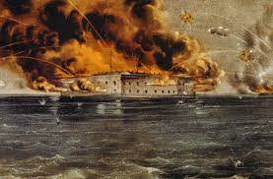
First Shots
Fort Sumter, South Carolina 1861
a federal fort located in the harbor of Charleston, South Carolina South attacked on April 12,1861 to officially start the Civil War
Confederate Victory: Force Union to Surrender

Slide 8
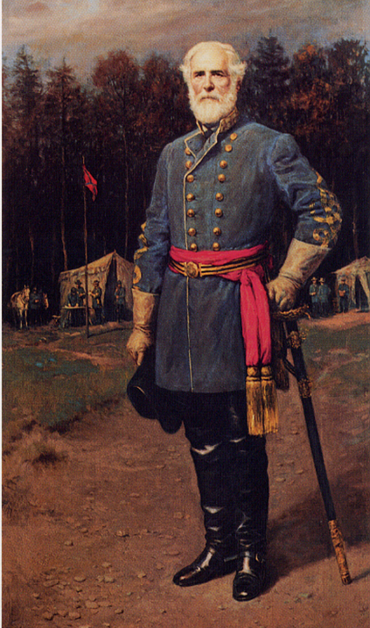
Preparing for Battle
Confederate General ROBERT E. LEE
After Virginia seceded, Lee resigned from US army, joined Confederacy
Confederate States planned a DEFENSIVE war
They also hoped for help from foreign allies such as Britain and France (cotton)

Slide 9
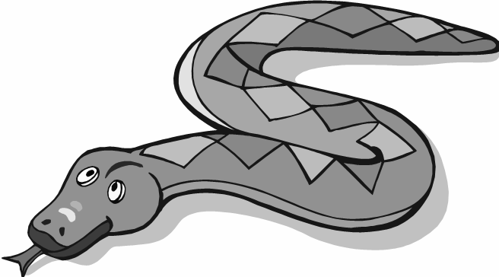
Union Strategy
Anaconda Plan
Plan to gain advantage over the South and secure an easy victory for the North
3 goals:
Blockade Southern coastline to prevent traffic of goods and people
Take control of Mississippi River to split Confederate States in half
Capture Richmond, VA- Confederate capital

Slide 10
Bellwork-- Thursday 4/27
Fill out CW/HW
Bring any colored pencils/markers
Is the statement Union or Confederacy?
Successfully attacked Fort Sumter
In the first weeks of war, 4 more states joined
West Virginia joined this side
Fighting a defensive war, battles on our territory
Hoped for military aid from GB & France
Had the Anaconda Plan
Richmond, VA was the capital of this side

Slide 11
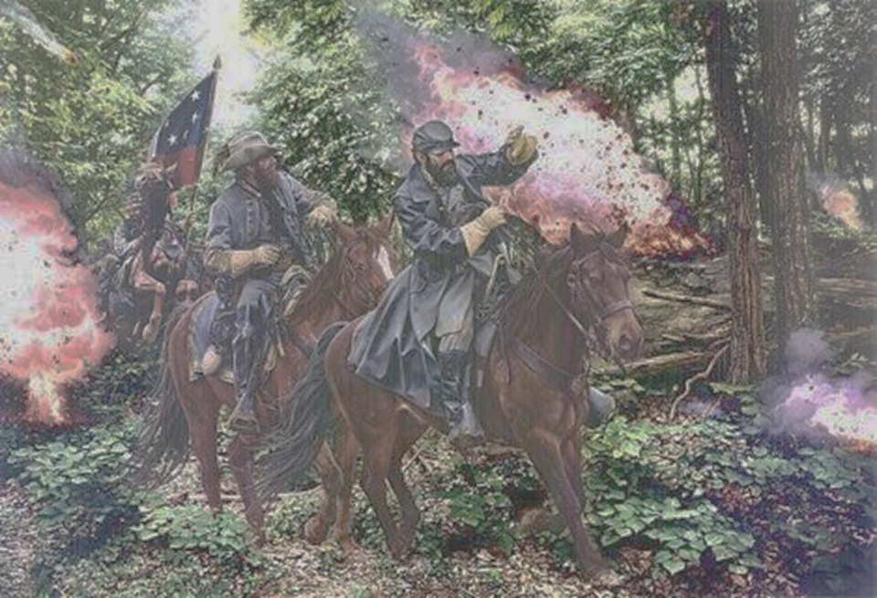
Battle at Bull Run
Union spectators came to VA to watch North easily defeat South
At first Union’s plan was successful but Confederate troops led by STONEWALL JACKSON rallied and defeated Union
Escape routes blocked by spectators and chaos caused many Union casualties

Slide 12
Battle at Shiloh
April 1862
Bloodiest battle up until that point
Union victory but with staggering costs:
Union troops: 65,000 with 13,000 casualties
Confederate troops: 41,000 with 11,000 casualties
HORRIFIC bloodshed and carnage

Slide 13
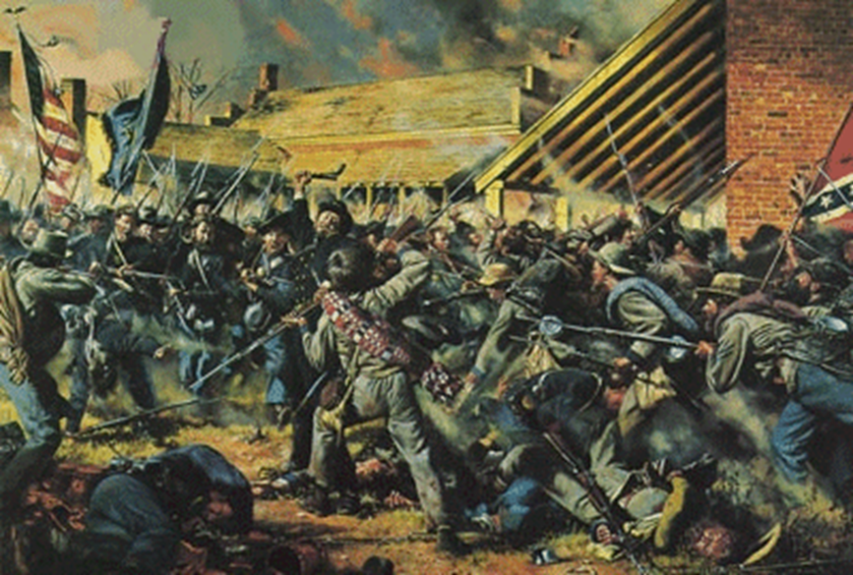

Slide 14
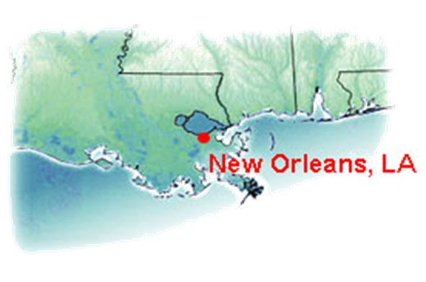
New Orleans
Union captured largest city in the South
This helped Union split Confederacy in half
Hindered South because they lost MOST control of Mississippi River

Slide 15
Bellwork-- Friday 4/28
Fill out HW/CW
Bring any colored pencils/markers
Why was the Union surprised by the outcome of Bull Run?

Slide 16
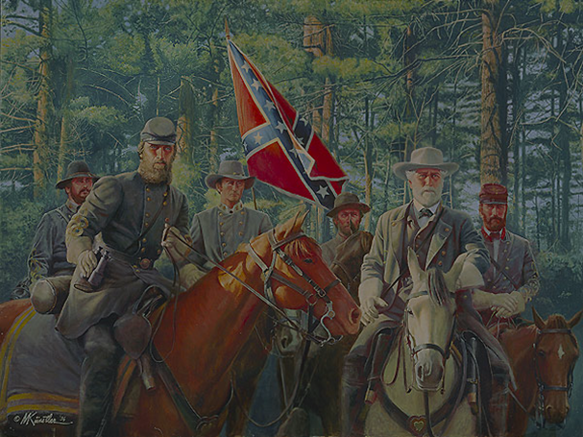
7 Days’ Battle
Week of fighting in the east
16,000 Union casualties and 20,000 Confederate
Although South lost more men, they forced Union to retreat foiling Union’s plan to capture Richmond

Slide 17
Antietam
BATTLE OF ANTIETAM – Sept 1862 – bloodiest day in American history 25,000 men killed, Union victory but missed a chance to follow up the battle and finish the Southern army

Slide 18
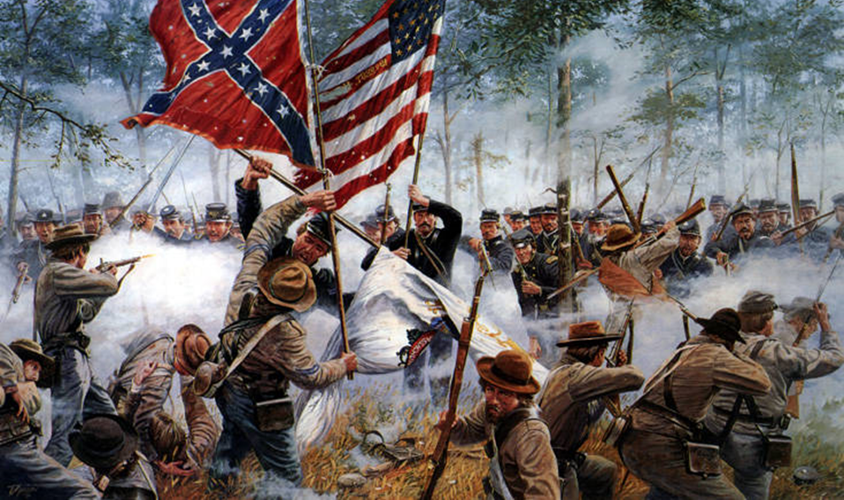

Slide 19
Bellwork-- Tuesday 5/2
Fill out CW/HW
Have comp. book out ready for notes
Do not get posters yet
Why did Congressmen criticize Grant and why did Lincoln like him?

Slide 20
LIFE AS A SOLDIER
Young soldiers: Most 16-23
Enlisted for Adventure, Money, Patriotism, Glory, Loyalty
Lack of supplies on BOTH sides: uniforms, boots, food, ammo

Slide 22
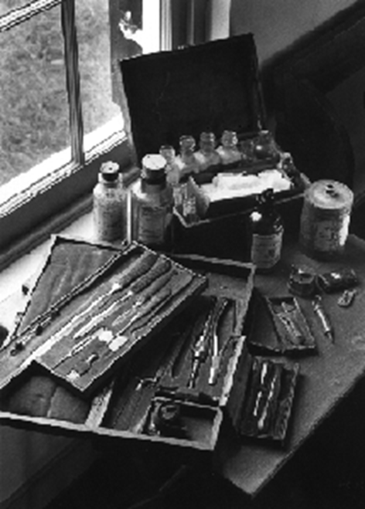
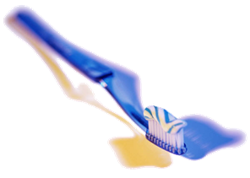
MAIN CAUSE OF DEATH
620,000 Americans died in Civil War
Many died from disease and sickness
Dirty water, poor hygiene, filthy medical equipment

Slide 23
Bellwork-- Thursday 5/4
Fill out CW/HW
What happened during the battle between the Monitor the the Merrimack? Why?

Slide 24
Technology
Ironclads: new naval ships. Powered by steam with iron sides. FAST and practically indestructible
Rifles and grenades- accuracy of gunfire, explode on impact
Minie Balls: bullet with a hollow base, shot further and more accurate than a musket

Slide 25
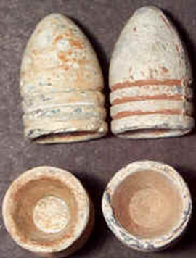
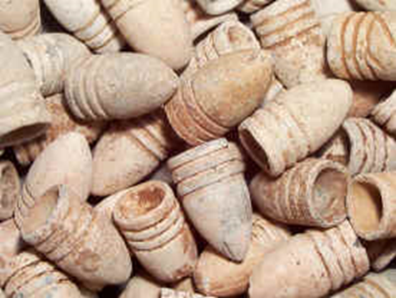

Slide 27
Bellwork-- Friday 5/5
Fill out CW/HW
Make sure you have something to work if you finish early-- it will NOT be social time
Why did the introduction of ironclad warships have such an impact on naval warfare?

